Slide 1

Data Structures for Java
William H. Ford
William R. Topp
Chapter 16
Binary Trees
Bret Ford
© 2005, Prentice Hall

Slide 2
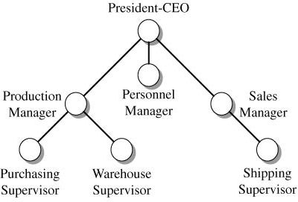
Tree Example

Slide 3
Tree Structures
A tree is a hierarchical structure that places elements in nodes along branches that originate from a root.
Nodes in a tree are subdivided into levels in which the topmost level holds the root node.
Any node in a tree can have multiple successors at the next level. Hence, a tree is a nonlinear structure.

Slide 4
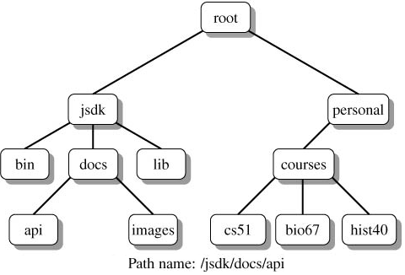
Tree Structures (continued)
Operating systems use a general tree to maintain file structures.

Slide 5
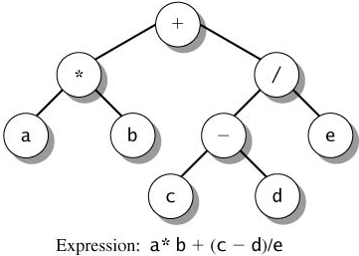
Tree Structures (continued)
In a binary tree each node has at most two successors. A compiler builds binary trees while parsing expressions in a program's source code.

Slide 6
Tree Terminology
A tree structure is characterized as a collection of nodes that originate from a unique starting node called the root.
  Each node consists of a value and a set of zero or more links to successor nodes.
  The terms parent and child describe the relationship between a node and any of its successor nodes.

Slide 7
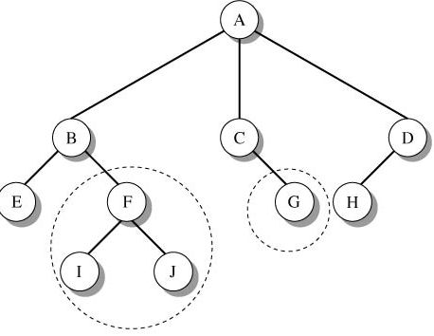
Tree Terminology (continued)

Slide 8
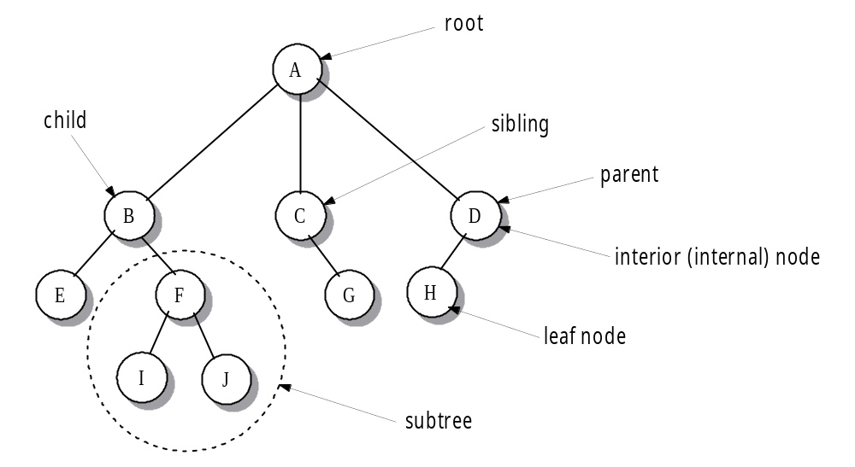
Tree Terminology (continued)

Slide 9
Tree Terminology (continued)
A path between a parent node P and
any node N in its subtree is a sequence of nodes P=X₀, X₁, . . ., X_{k} = N where k is the length of the path. Each node X_{i} in the sequence is the parent of X_{i}+1 for 0 ≤ i ≤ k-1.
  The level of a node is the length of the path from root to the node. Viewing a node as a root of its subtree, the height of a node is the length of the longest path from the node to a leaf in the subtree.
  The height of a tree is the maximum level in the tree.

Slide 10
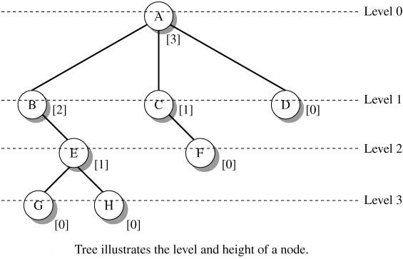
Tree Terminology (continued)

Slide 11
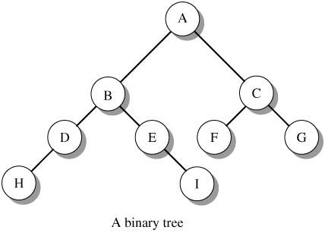
Binary Trees
In a binary tree, each parent has no
more than two children.
A binary tree has a uniform structure that allows a simple description of its node structure and the development of a variety of tree algorithms.

Slide 12
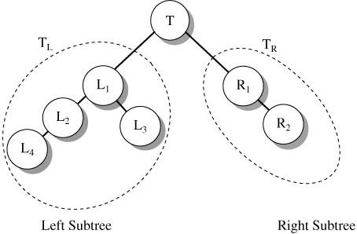
Binary Trees (continued)
Each node of a binary tree defines a left and a right subtree. Each subtree is itself a tree.
Right child of T
Left child of T

Slide 13
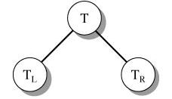
Binary Trees (continued)
An alternative recursive definition of a binary tree:
  T is a binary tree if T
    has no node (T is an empty tree)
    or
    has at most two subtrees.

Slide 14
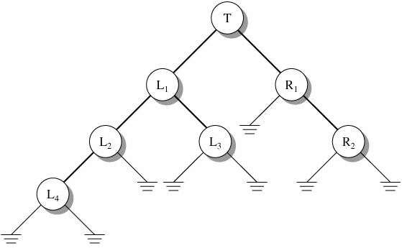
Binary Trees (continued)

Slide 15
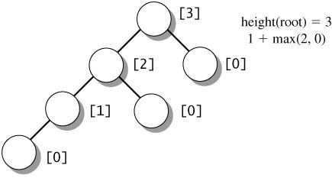
Height of a Binary Tree
The height of a binary tree is the length of the longest path from the root to a leaf node. Let T_{N} be the subtree with root N and T_{L} and T_{R} be the roots of the left and right subtrees of N. Then
{
-1 if T_{N} is empty
1+max( height(T_{L}), height(T_{R})) if T_{N} not empty
height(N) = height(T_{N}) =

Slide 16
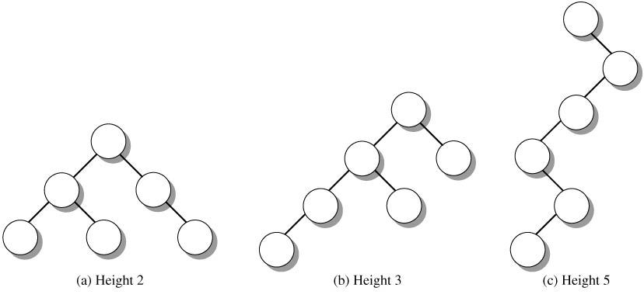
Height of a Binary Tree (concluded)
Degenerate binary tree

Slide 17
Density of a Binary Tree
In a binary trees, the number of nodes at each level falls within a range of values.
  At level 0, there is 1 node, the root; at level 1 there can be 1 or 2 nodes.
  At any level k, the number of nodes is in the range from 1 to 2^{k}.
  The number of nodes per level contributes to the density of the tree. Intuitively, density is a measure of the size of a tree (number of nodes) relative to the height of the tree.

Slide 18
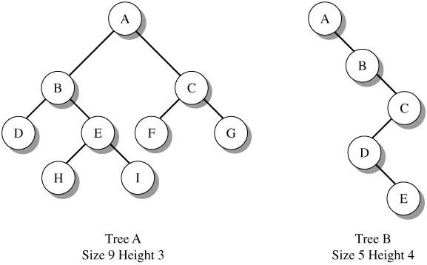
Density of a Binary Tree (continued)

Slide 19
Density of a Binary Tree (continued)
A complete binary tree of height h has all possible nodes through level h-1, and the nodes on depth h exist left to right with no gaps.

Slide 20
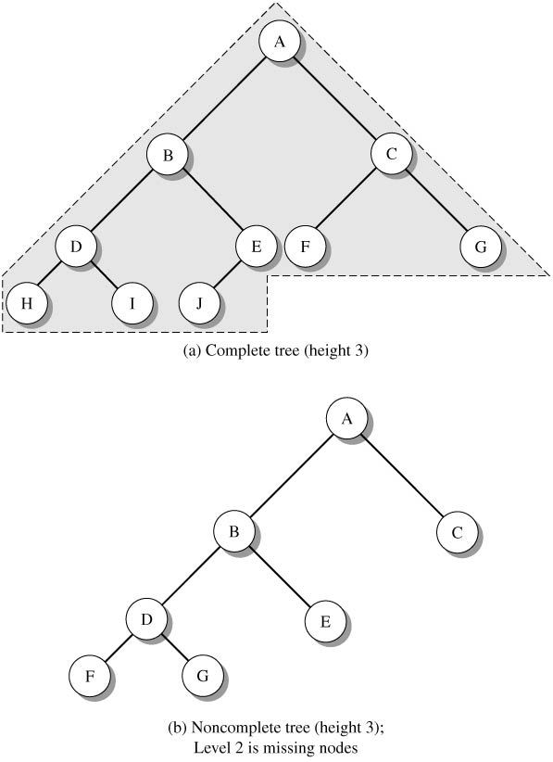
Density of a Binary Tree (continued)

Slide 21
Density of a Binary Tree (continued)
Determine the minimum height of a complete tree that holds n elements.
  Through the first h - 1 levels, the total number of nodes is
  1 + 2 + 4 + ... + 2^{h-1} = 2^{h} - 1
  At depth h, the number of additional nodes ranges from a minimum of 1 to a maximum of 2^{h}.
  Hence the number of nodes n in a complete binary tree of height h ranges between
  2^{h} - 1 + 1 = 2^{h} ≤ n ≤ 2^{h} - 1 + 2^{h} = 2^{h+1} - 1 < 2^{h}+1

Slide 22
Density of a Binary Tree (continued)
After applying the logarithm base 2 to all terms in the inequality, we have
h ≤ log₂ n < h+1
and conclude that a complete binary tree with n nodes must have height
h = int(log₂n)

Slide 23
Density of a Binary Tree (concluded)
Number of elements (n) | Calculation (log₂n) | Height (h = int(log₂n))
10 | log₂ 10 = 3.321 | int(3.321) = 3
5000 | log₂5000 = 12.287 | int(12.287) = 12
1000000 | log₂ 1000000 = 19.931 | int(19.931) = 19

Slide 24

Binary Tree Nodes
Define a binary tree a node as an instance of the generic TNode class.
  A node contains three fields.
    The data value, called nodeValue.
    The reference variables, left and right that identify the left child and the right child of the node respectively.

Slide 25
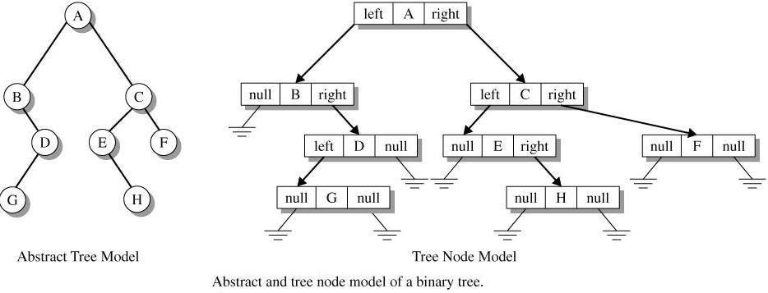
Binary Tree Nodes (continued)

Slide 26
Binary Tree Nodes (continued)
The TNode class allows us to construct
a binary tree as a collection of TNode objects.

Slide 27
TNode Class
public class TNode<T>
{
// node's value
public T nodeValue;
// subtree references
public TNode<T> left, right;
// create instance with a value and null subtrees
public TNode(T item)
{
nodeValue = item;
left = right = null;
}

Slide 28
TNode Class (concluded)
// initialize the value and the subtrees
public TNode (T item, TNode<T> left, TNode<T> right)
{
nodeValue = item;
this.left = left;
this.right = right;
}
}

Slide 29
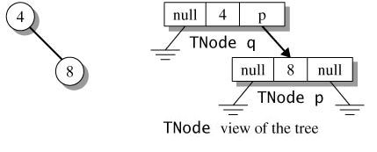
Building a Binary Tree
A binary tree consists of a collection of TNode objects whose reference values specify links to their children. Build a binary tree one node at a time.
TNode<Integer> p, q; // references to TNode objects with
// Integer data
// p is a leaf node with value 8;
p = new TNode<Integer>(8);
// q is a node with value 4 and p as a right child
q = new TNode<Integer>(4, null, p);

Slide 30
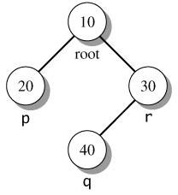
Building a Binary Tree (continued)
Use the TNode class to build a binary
tree from the bottom up.
// references to Integer tree nodes
TNode<Integer> root, p, q, r;
// create leaf node p with value 20
// and leaf node q with value 40
p = new TNode<Integer>(20);
q = new TNode<Integer>(40);
// create internal node r with value 30,
// left child q, and a null right child
r = new TNode<Integer>(30, q, null);
// create root node with value 10,
// left child p, and right child r
root = new TNode<Integer>(10, p, r);

Slide 31
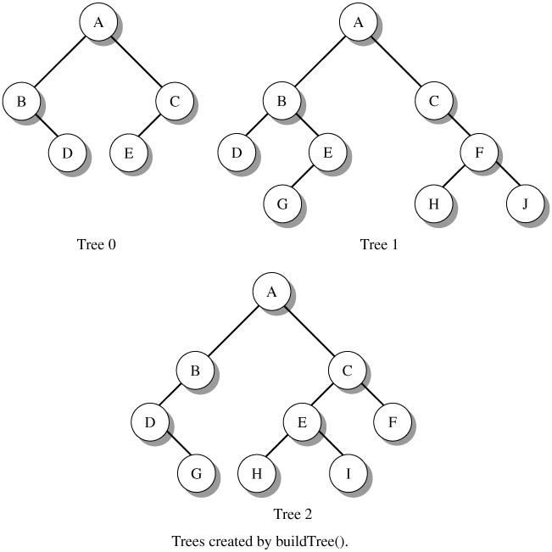
Building a Binary Tree (concluded)
// n is in the range 0 to 2
public static TNode<Character> buildTree(int n)
{ ... }

Slide 32
Recursive Binary Tree-Scan Algorithms
To scan a tree recursively we must visit the node (N), scan the left subree (L), and scan the right subtree (R). The order in which we perform the N, L, R tasks determines the scan algorithm.

Slide 33
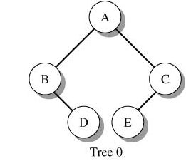
Inorder Scan
The inorder scan of a tree visits the
left subtree L, visits the node N, then visits the right subtree R. To scan the entire tree, begin with the root.
Scan order: B D A E C

Slide 34
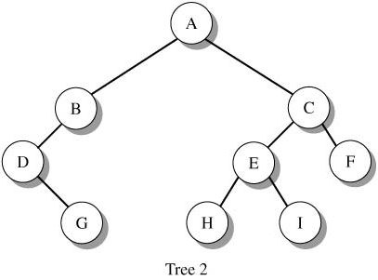
Recursive Scanning Example
Preorder (NLR): A B D G C E H I F
Inorder (LNR): D G B A H E I C F
Postorder (LRN): G D B H I E F C A

Slide 35
Designing Recursive Scanning Methods
Recursive Scan Design Pattern (assuming an inorder scan (L N R) and
a return value)
public static <T> ReturnType scanMethod(TNode<T> t)
{
// check for empty tree (stopping condition)
if (t == null)
< return information for an empty tree >
else
{ // descend to left subtree and record return information
valueLeft = scanMethod(t.left);
// visit the node and record information
< evaluate t.nodeValue >
// descend to right subtree and record return information
valueRight = scanMethod(t.right);
}
return <information from valueLeft, valueRight,
and t.nodeValue >
}

Slide 36
Designing Scanning Methods (concluded)
Preorder Design Pattern:
<evaluate t.nodeValue> // visit node first
valueLeft = scanMethod(t.left); // go left
valueRight = scanMethod(t.right); // go right
Postorder Design Pattern:
valueLeft = scanMethod(t.left); // go left
valueRight = scanMethod(t.right); // go right
<evaluate t.nodeValue> // visit node last

Slide 37
Console Output for an Inorder Scan
// list the nodes of a binary tree using an LNR scan
public static <T> void inorderOutput(TNode<T> t)
{
// the recursive scan terminates on an empty subtree
if (t != null)
{
inorderOutput(t.left); // descend left
System.out.print(t.nodeValue + " ");
inorderOutput(t.right); // descend right
}
}

Slide 38
inorderDisplay()
// list the nodes of a binary tree using an LNR scan
public static <T> String inorderDisplay(TNode<T> t)
{
// return value
String s = "";
// the recursive scan terminates on a empty subtree
if (t != null)
{
s += inorderDisplay(t.left); // descend left
s += t.nodeValue + " "; // display the node
s += inorderDisplay(t.right); // descend right
}
return s;
}

Slide 39
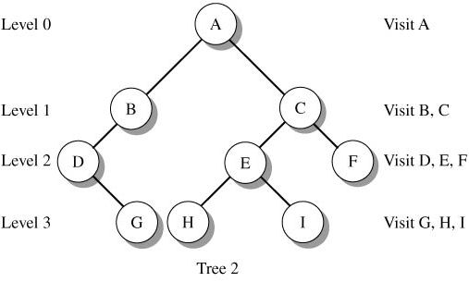
Iterative Level-Order Scan
A level-order scan visits the root, then nodes on level 1, then nodes on level 2, etc.

Slide 40
Iterative Level-Order Scan (continued)
A level-order scan is an iterative process that uses a queue as an intermediate storage collection.
  Initially, the root enters the queue.
  Pop a node from the queue, perform some action with the node, and then push its children onto the queue. Because siblings enter the queue during a visit of their parent, the siblings (on the same level) will exit the queue in successive iterations.

Slide 41
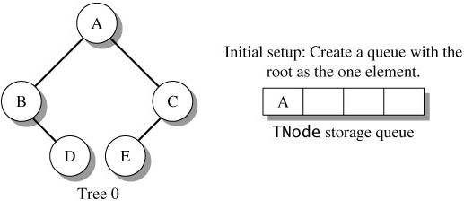




Iterative Level-Order Scan (continued)
Pop C. Push E
Pop
Pop A. Push B, C
Pop B. Push D

Slide 42
Iterative Level-Order Scan (continued)
Pop D
Pop E
Pop A. Push B, C
Visit: A B C D E
Pop B. Push D
Pop C. Push E

Slide 43
levelorderDisplay()
// list the value of each node in a binary tree using a
// level order scan of the nodes
public static <T> String levelorderDisplay(TNode<T> t)
{
// store siblings of each node in a queue
// so that they are visited in order at the
// next level of the tree
LinkedQueue<TNode<T>> q =
new LinkedQueue<TNode<T>>();
TNode<T> p;
// return value
String s = "";
// initialize the queue by inserting the
// root in the queue
q.push(t);

Slide 44
levelorderDisplay()
(continued)
// continue the iterative process until
// the queue is empty
while(!q.isEmpty())
{
// delete a node from queue and output
// the node value
p = q.pop();
s += p.nodeValue + " ";
// if a left child exists, insert it in the queue
if(p.left != null)
q.push(p.left);

Slide 45
levelorderDisplay()
(concluded)
// if a right child exists, insert next
// to its sibling
if(p.right != null)
q.push(p.right);
}
return s;
}

Slide 46
Visitor Design Pattern
The Visitor design pattern applies an action to each element of a collection.
The Visitor interface defines the visit() method which denotes what a visitor does. For a specific visitor pattern, create a class that implements the Visitor interface. During traversal, call visit() and pass the current value as an argument
public interface Visitor<T>
{
void visit(T item);
}

Slide 47
Visitor Design Pattern (continued)
public class VisitOutput<T> implements Visitor<T>
{
public void visit(T obj)
{
System.out.print(obj + " ");
}
}

Slide 48
Visitor Design Pattern (continued)
public class VisitMax<T extends Comparable<? super T>>
implements Visitor<T>
{
T max = null;
public void visit(T obj)
{
if (max == null)
max = obj;
else if (obj.compareTo(max) > 0)
max = obj;
}
public T getMax()
{
return max;
}
}

Slide 49
scanInorder()
The recursive method scanInorder()
provides a generalized inorder traversal of a tree that performs an action specified by a visitor pattern.
public static <T> void scanInorder (TNode<T> t,
Visitor<T> v)
{
if (t != null)
{
scanInorder(t.left, v);
v.visit(t.nodeValue);
scanInorder(t.right, v);
}
}

Slide 50
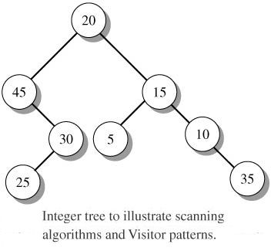
Program 16.1

Slide 51
Program 16.1 (continued)
import ds.util.TNode;
import ds.util.BinaryTree;
public class Program16_1
{
public static void main(String[] args)
{
// root of the tree
TNode<Integer> root;
// create the Visitor objects
VisitOutput<Integer> output =
new VisitOutput<Integer>();
VisitMax<Integer> max = new VisitMax<Integer>();
// create the tree using buildTree16_1
root = buildTree16_1();

Slide 52
Program 16.1 (continued)
// output the recursive scans and
// the level order scan
System.out.println("Scans of the tree");
System.out.println(" Preorder scan: " +
BinaryTree.preorderDisplay(root));
System.out.println(" Inorder scan: " +
BinaryTree.inorderDisplay(root));
System.out.println(" Postorder scan: " +
BinaryTree.postorderDisplay(root));
System.out.println(" Level order scan: " +
BinaryTree.levelorderDisplay(root) + "\n");
// use Vistor object and scanInorder()
// to traverse the tree and determine
// the maximum value
System.out.println(
"Call scanInorder() with VisitOutput: ");
scanInorder(root, output);
System.out.println();

Slide 53
Program 16.1 (continued)
scanInorder(root, max);
System.out.println(
"Call scanInorder() with VisitMax: " +
"Max value is " + max.getMax());
}
public static <T> void scanInorder(TNode<T> t,
Visitor<T> v)
{
if (t != null)
{
scanInorder(t.left, v);
v.visit(t.nodeValue);
scanInorder(t.right, v);
}
}

Slide 54
Program 16.1 (concluded)
public static TNode<Integer> buildTree16_1()
{
// TNode references; point to
// the 8 items in the tree
TNode<Integer> root20 = null, t45, t15, t30,
t5, t10, t25, t35;
t35 = new TNode<Integer>(35);
t25 = new TNode<Integer>(25);
t10 = new TNode<Integer>(10, null, t35);
t5 = new TNode<Integer>(5);
t30 = new TNode<Integer>(30, t25, null);
t15 = new TNode<Integer>(15, t5, t10);
t45 = new TNode<Integer>(45, null, t30);
root20 = new TNode<Integer>(20, t45, t15);
return root20;
}
}

Slide 55
Program 16.1 (Run)
Scans of the tree
Preorder scan: 20 45 30 25 15 5 10 35
Inorder scan: 45 25 30 20 5 15 10 35
Postorder scan: 25 30 45 5 35 10 15 20
Level order scan: 20 45 15 30 5 10 25 35
Call scanInorder() with VisitOutput:
45 25 30 20 5 15 10 35
Call scanInorder() with VisitMax: Max value is 45

Slide 56
Generalizing Use of the Visitor Design Pattern
The Visitor pattern does not only apply to binary trees. It is easy to apply the pattern to any object that implements the Collection interface. The method, traverse(), has Collection and Visitor parameters. An iterator sequences through the collection and passes the data value to the Visitor object.

Slide 57
traverse()
// traverse c and apply the Visitor pattern to each
// of its values
public static <T> void traverse(Collection<T> c,
Visitor<T> v)
{
Iterator<T> iter = c.iterator();
while (iter.hasNext())
v.visit(iter.next());
}

Slide 58
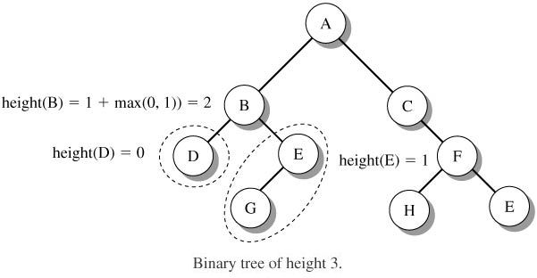
Computing Tree Height
Recall that the height of a binary tree can be computed recursively.
{
-1 if T is empty
height(T) =
1 + max(height(T_{L}), height(T_{R})) if T is nonempty

Slide 59
Computing Tree Height (continued)
// determine the height of the tree
// using a postorder scan
public static <T> int height(TNode<T> t)
{
int heightLeft, heightRight, heightval;
if (t == null)
// height of an empty tree is -1
heightval = -1;
else
{
// find the height of the left subtree of t
heightLeft = height(t.left);
// find the height of the right subtree of t
heightRight = height(t.right);

Slide 60
Computing Tree Height (concluded)
// height of the tree with root t is 1 + maximum
// of the heights of the two subtrees
heightval = 1 +
(heightLeft > heightRight ? heightLeft :
heightRight);
}
return heightval;
}

Slide 61
Copying a Binary Tree
In many applications, a programmer wants to duplicate a tree structure.
  The duplicate configures nodes with the same parent to child relationships although the data may include additional information that is specific to the application.
    The duplicate tree may contain nodes that have an additional field (thread) that references the parent. The duplicate allows the programmer to scan up the tree along the path of parents.

Slide 62
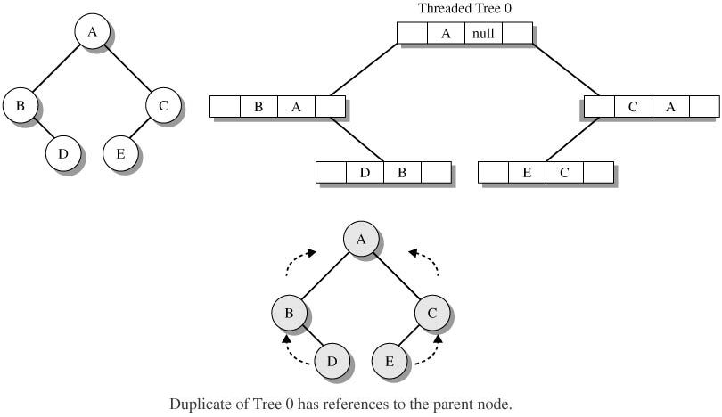
Copying a Binary Tree (continued)

Slide 63
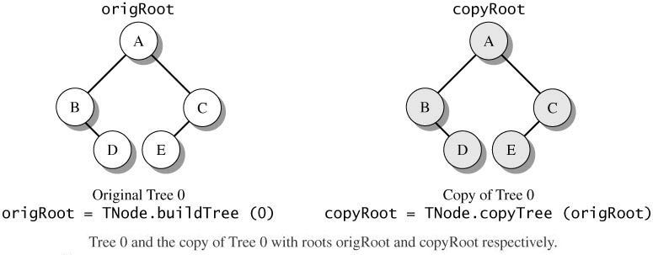
Copying a Binary Tree (continued)
Copy a tree using a postorder scan. This builds the duplicate tree from the bottom up.
public static <T> TNode<T> copyTree(TNode<T> t)

Slide 64
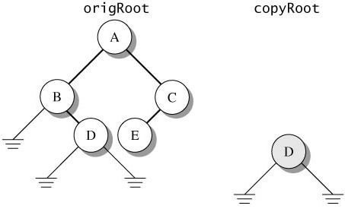
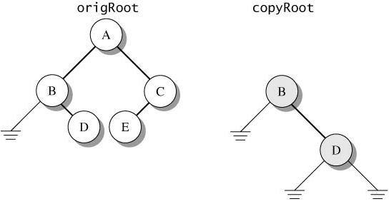
Copying a Binary Tree (continued)

Slide 65
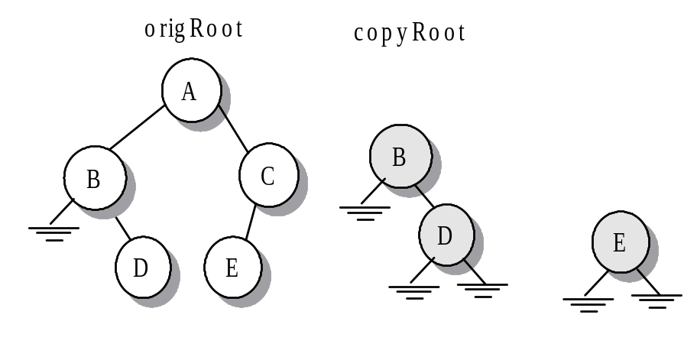
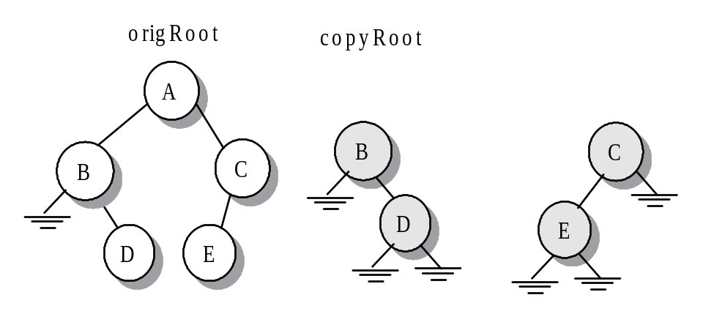
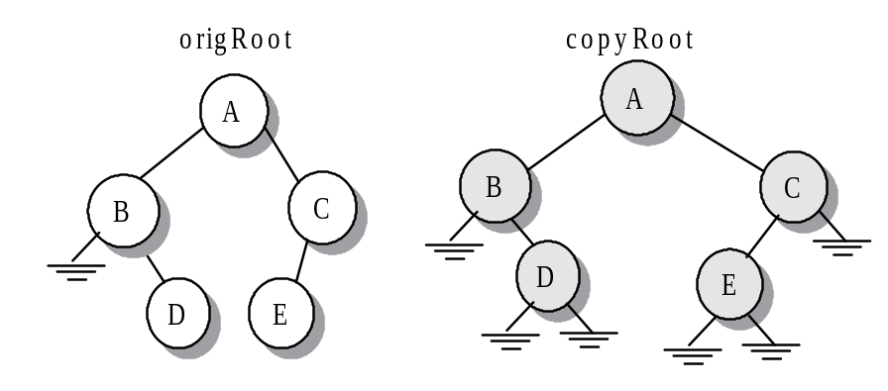
Copying a Binary Tree (continued)

Slide 66
Copying a Binary Tree (continued)
// create a duplicate of the tree with root t and return
// a reference to its root
public static <T> TNode<T> copyTree(TNode<T> t)
{
// newNode points at a new node that the algorithm
// creates; newLptr and newRptr point to the subtrees
// of newNode
TNode<T> newLeft, newRight, newNode;
// stop the recursive scan when we
// arrive at empty tree
if (t == null)
return null;

Slide 67
Copying a Binary Tree (concluded)
// build the new tree from the bottom up by building
// the two subtrees and then building the parent; at
// node t, make a copy of the left subtree and assign
// its root node reference to newLeft; make a copy of
// the right subtree and assign its root node
// reference to newRight
newLeft = copyTree(t.left);
newRight = copyTree(t.right);
// create a new node whose value is the same
// as the value in t and whose children are the
// copied subtrees
newNode = new TNode<T> (t.nodeValue, newLeft,
newRight);
// return a reference to the root of the
// newly copied tree
return newNode;
}

Slide 68
Clearing a Binary Tree
Clear a tree with a postorder scan. It removes the left and right subtrees before removing the node.
public static <T> void clearTree(TNode<T> t)
{
// postorder scan; delete left and right
// subtrees of t and then node t
if (t != null)
{
clearTree(t.left);
clearTree(t.right);
t = null;
}
}

Slide 69
Displaying a Binary Tree
BinaryTree.displayTree() returns a string that has a layout of the node values in a binary tree. BinaryTree.drawTree() gives a graphical view of the tree.
// return a string that displays a binary tree. output of
// a node value requires no more than maxCharacters
public static <T>
String displayTree(TNode<T> t, int maxCharacters)
{ ... }
// displays a tree in a graphical window
public static <T>
void drawTree(TNode<T> t, int maxCharacters)
{ ... }

Slide 70
Program 16.2
import ds.util.TNode;
import ds.util.BinaryTree;
public class Program16_2
{
public static void main(String[] args)
{
// roots for two trees
TNode<Character> root, copyRoot;
// build the character Tree 2 with root root2
root = BinaryTree.buildTree(2);
// display the original tree on the console
System.out.println(
BinaryTree.displayTree(root, 1));

Slide 71
Program 16.2 (concluded)
// make a copy of root1 so its root is root2
copyRoot = BinaryTree.copyTree(root);
// graphically display the tree copy
BinaryTree.drawTree(copyRoot, 1);
}
}

Slide 72
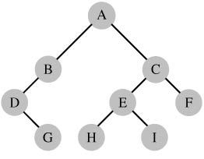
Run of Program 16.2
Run:
A
B C
D E F
G H I

Slide 73
A Lower Bound for Sorting
Are there are yet undiscovered sorting algorithms that use comparisons and have worst and average case running time better than O(n log₂n)? Since sorting is so important, it would pay to search for such an algorithm.

Slide 74
A Lower Bound for Sorting (continued)
Consider a decision tree for a sorting algorithm. Such a tree traces all the possible paths that occur when a sorting algorithm executes.
  Each internal node has the format "elt1:elt2", which means that we perform the test elt1 < elt2. The two edges from the node represent the results of the comparison, elt1 < elt2 or elt2 < elt1. The leaf nodes contain the final sorted sequence.

Slide 75
A Lower Bound for Sorting (continued)
Construct the decision tree for sorting the 3-element array {a, b, c} using the selection sort. For simplicity, assume that the array contains no duplicates.
  The next 2 slides show phases of the decision tree construction.

Slide 76

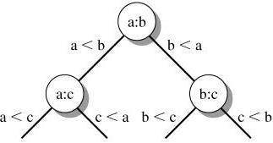
A Lower Bound for Sorting (continued)

Slide 77
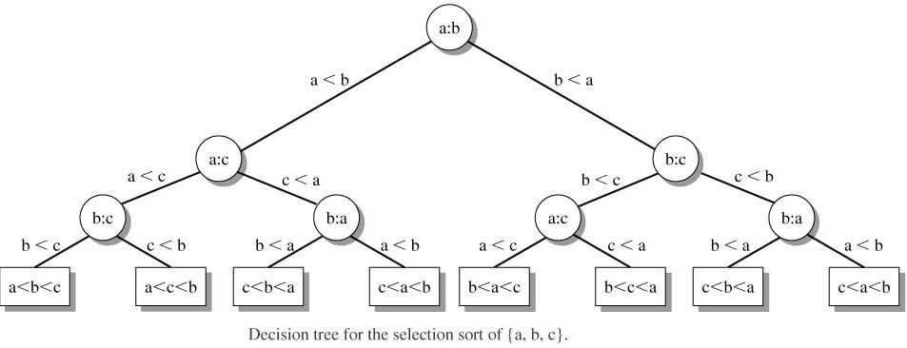
A Lower Bound for Sorting (continued)

Slide 78
A Lower Bound for Sorting (continued)
If an array has n elements, there must be at least n! leaf nodes in the decision tree for a sorting algorithm that uses comparisons.
If a binary tree has L leaf nodes, then
L ≤ 2^{h}
where h is the height of the tree, and so
n! ≤ 2^{h}
and
h ≥ log₂ (n!)

Slide 79
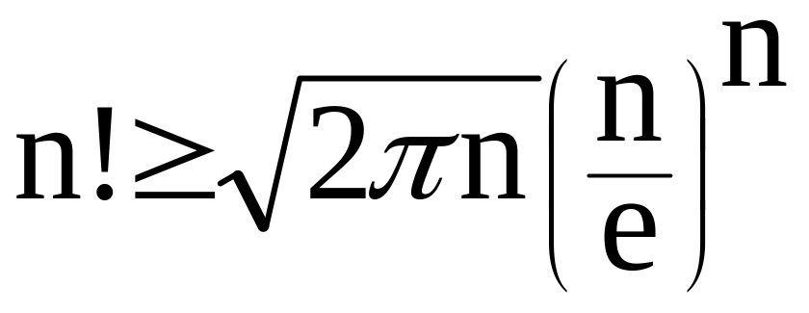
A Lower Bound for Sorting (continued)
It is known that
This implies
T(n) > n log₂ n - n log₂ e
where T(n) is the maximum number of comparisons required to sort n elements.

Slide 80
A Lower Bound for Sorting (concluded)
We have developed on of the most important results in computer science. Sorting algorithms using comparisons can have a running time no better than
O(n log₂ n). We say T(n) is Ω(n log₂n).
  If a friend tells you that he or she has discovered this fantastic sorting algorithm that uses comparisons and has running time
  O(n (log₂n)^{1/2}), your friend has made an error!

